Slide 1
EnviroBot
A Mobile Robotic Arm for Efficient Cleaning and Task Automation
Department Of
Information and Communication Technology
Comilla University
Presented By :
Jewel Nath (ID: 11909037)
Tasmiara Jahan Toma (ID: 11909048)
Tanjina Akter (ID: 11809008)
Dept of ICT, Comilla University

Slide 2
Contents
Introduction
Project Motivation
Aims & Objective
Literature review
Methodology
Robot Design
Bluetooth Control
ROS2 Workspace Setup
Rviz visualization
MoveIt Configuration
Model Train for Waste Detection
Integration Train Model with ROS2
Result and Finding
Future Work
Conclusion
References

Slide 3
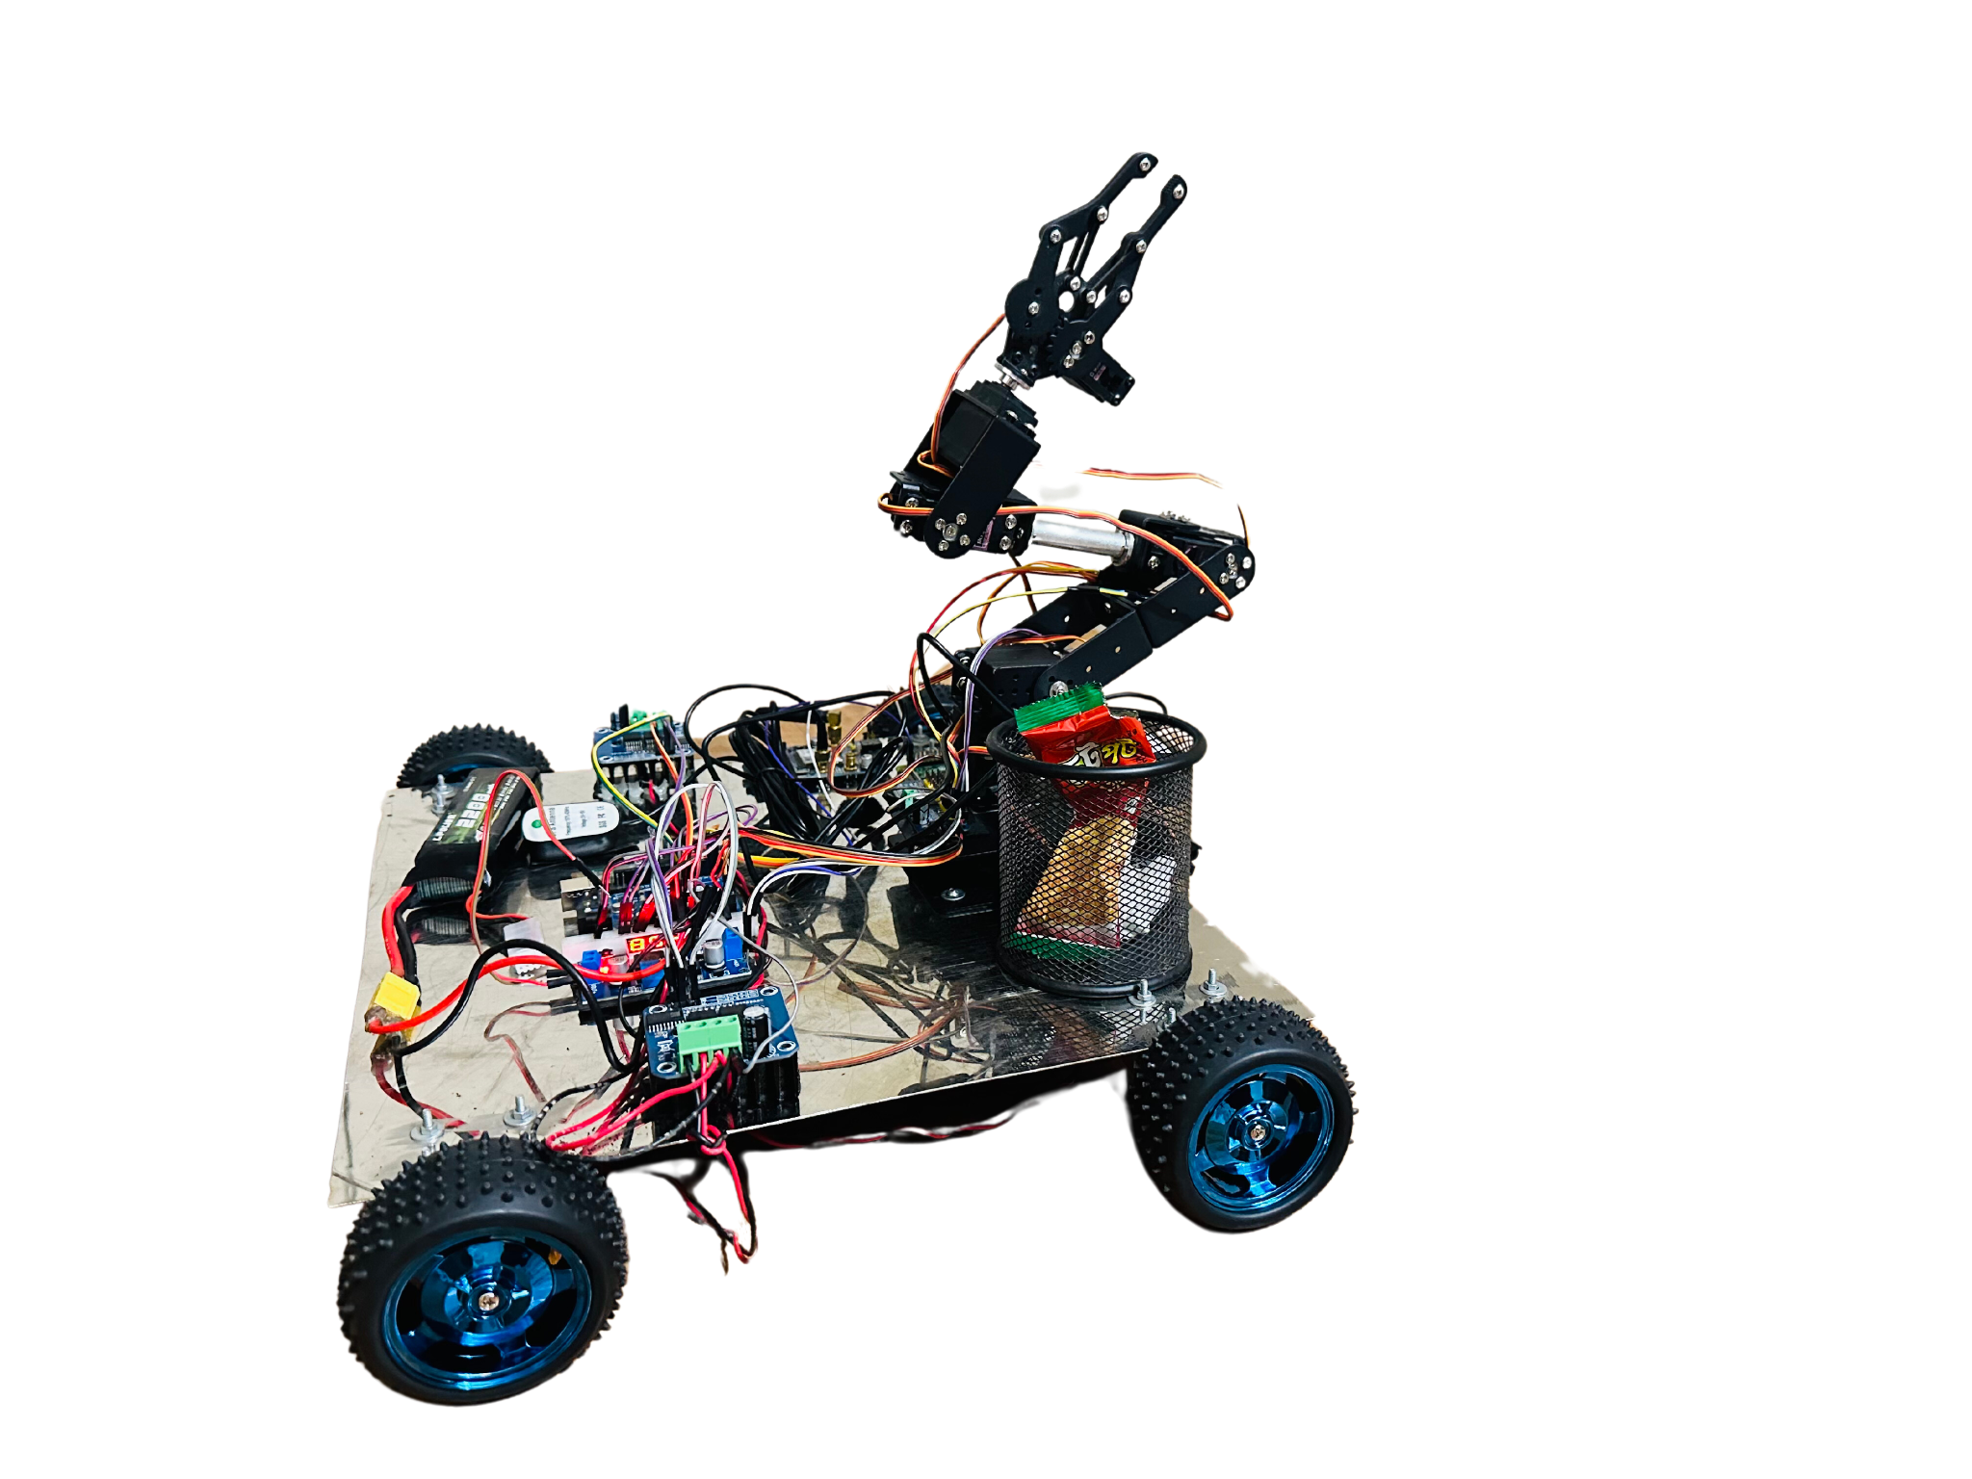
INTRODUCTION
A state-of-the-art waste management solution
A machine learning-driven robotic arm.
The holistic system showcases a transformative synergy between robotics and artificial intelligence,
providing a sustainable and technologically advanced approach to global waste management.

Slide 4
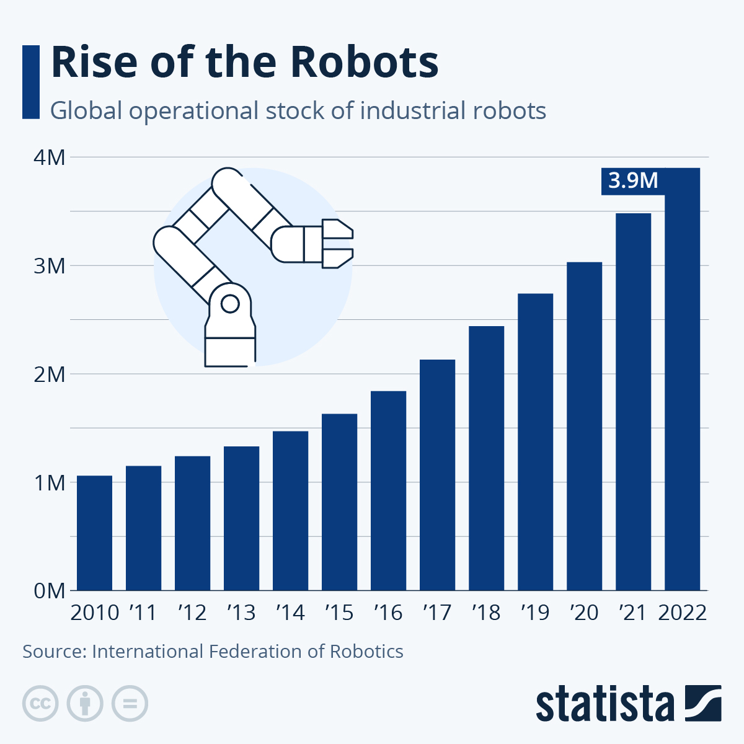
Motivation
based on data from the International Robotics Federation (IFR)
the operational stock of industrial robots has tripled over the past decade
Four million robots in use across various industries by the end of 2022.

Slide 5
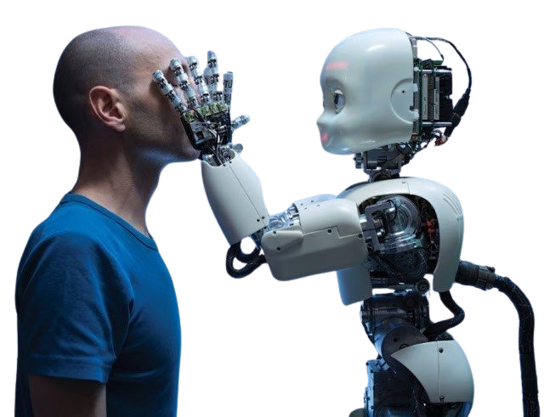
Aims & Objectives
1. Integration of Machine Learning and Robotic Framework:
Machine Learning in Robotics : Enabling Autonomous System
2. Data Collection and Storage:
- Systematically timestamps and stores collected data.
- Utilizes data to track waste trends, enhancing waste management practices, and devising innovative strategies for effective waste reduction.

Slide 6
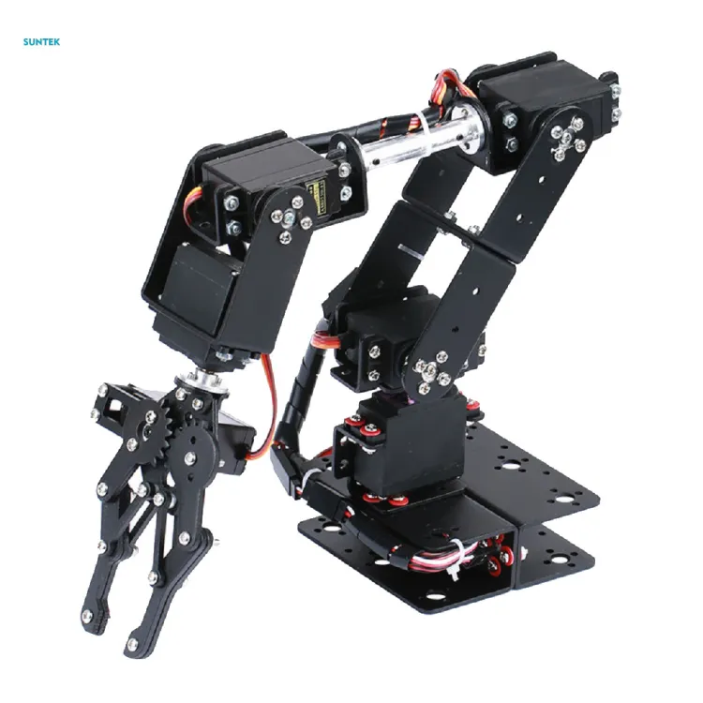
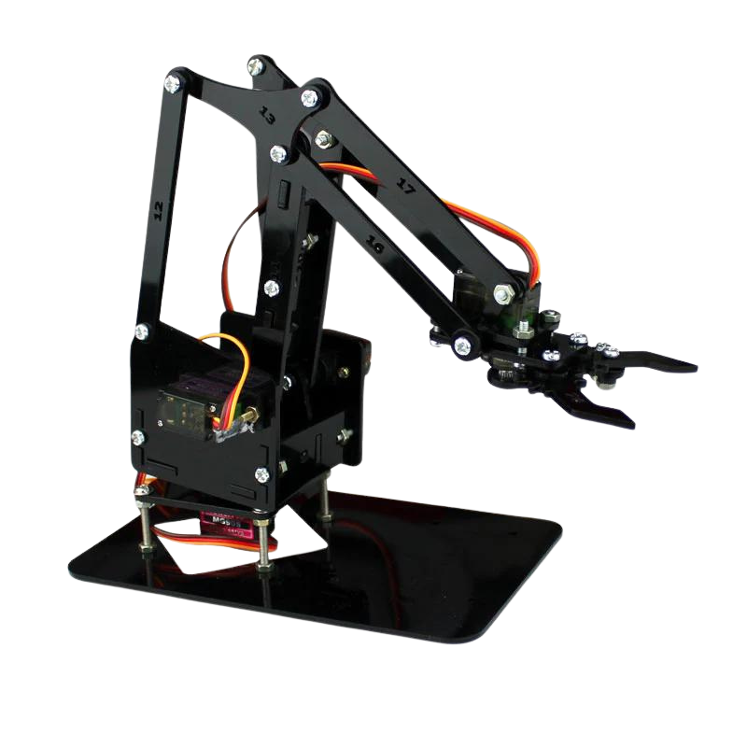
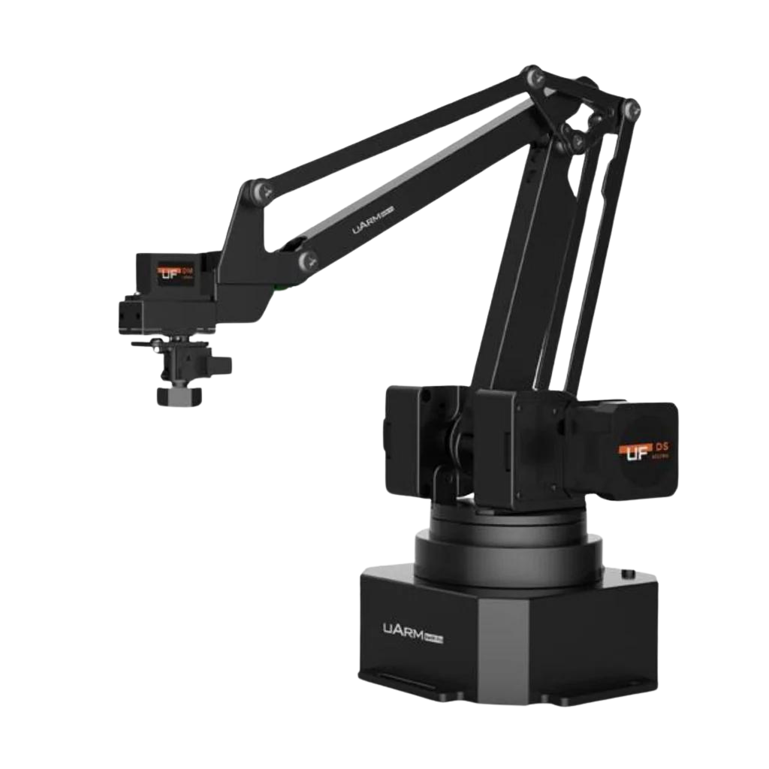
Literature Review
3 DOF vs 4 DOF vs 6 DOF[1]

Slide 7
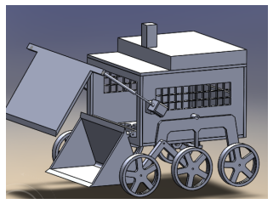
Literature Review
design and development of a semi-autonomous garbage collector robot
efficient waste collection and disposal in diverse settings.
Remote monitoring camera
controllable via voice command or a mobile application
Fig: semi-autonomous garbage collector robot[2]

Slide 8
Methodology
Hardware Tools
Hardware used for our project are:
Raspberry PI 3 model B
Arduino UNO
ESP32
6 DOF Aluminum Mechanical Robotic Arm Clamp Claw Mount
Servo Motor
16-channel servo driver
Xbox Kinect one-sensor camera
BTS7960 Motor Driver
12v, 300 RPM, 10kg Torque gear motor
Wheel
Motor Mount
Bluetooth
Step-down buck converter
12v 2200mAh Lipo Battery
Lipo battery charger
SS Sheet

Slide 9
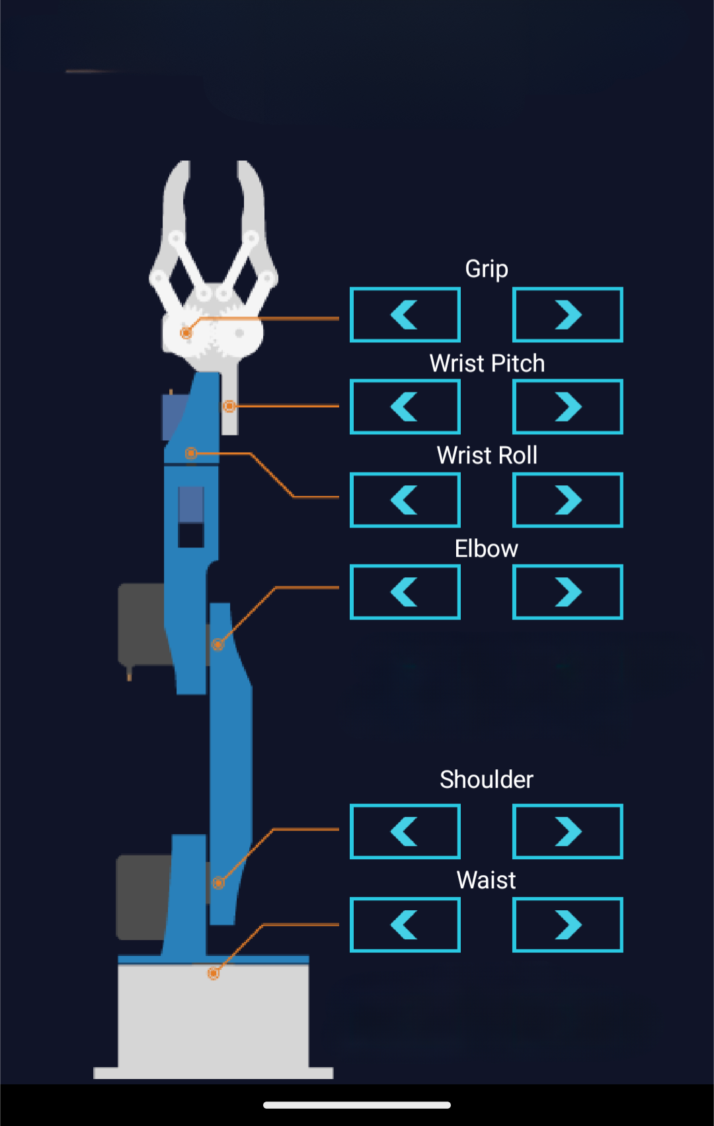
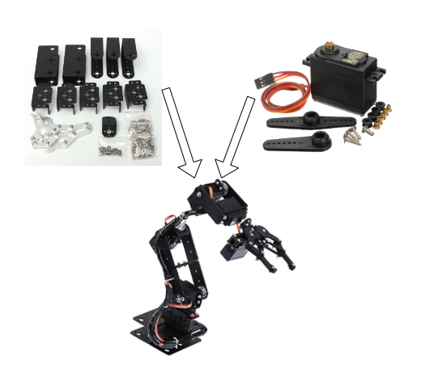
Methodology
Robot Design
Fig : Joint Structure

Slide 10
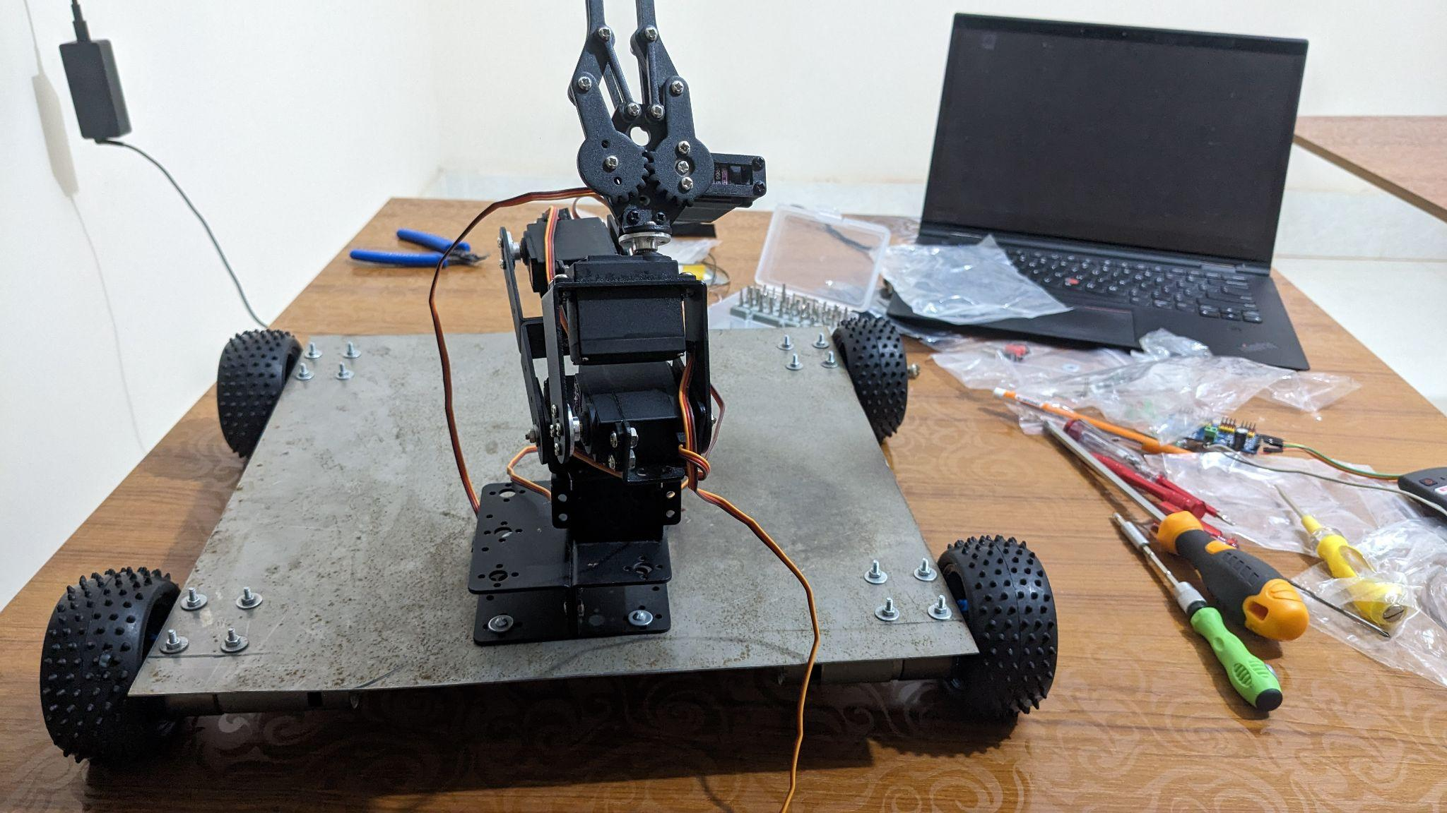
2. Integration of Robotic Arm and Rover

Slide 11
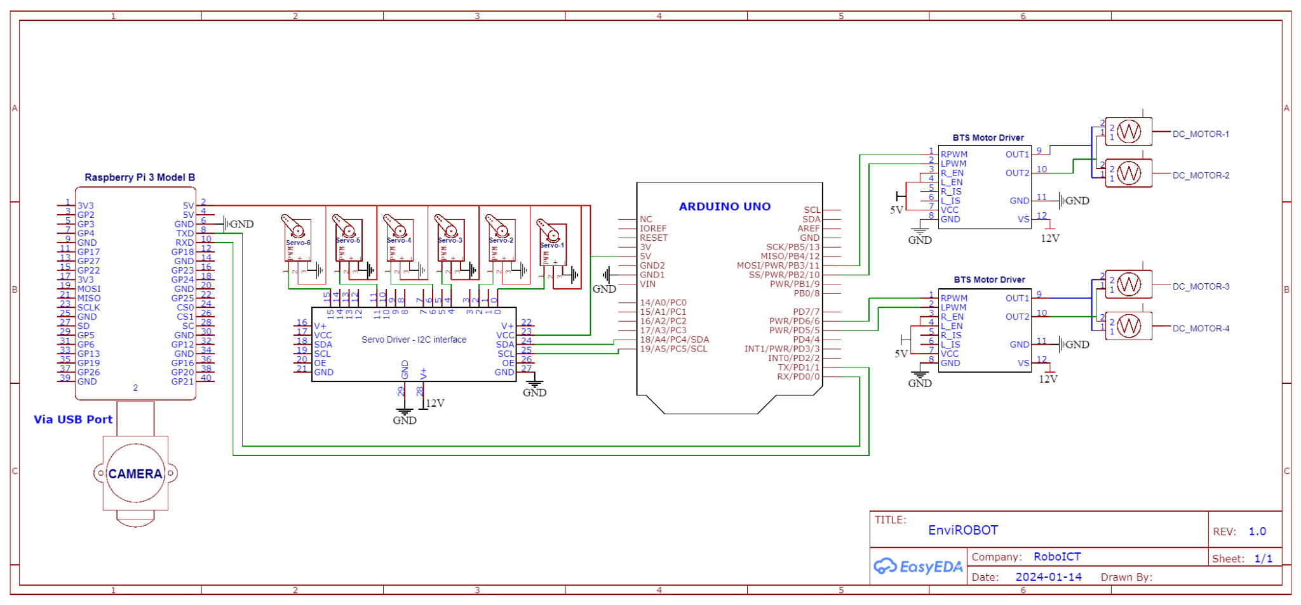
3. Circuit Diagram

Slide 12
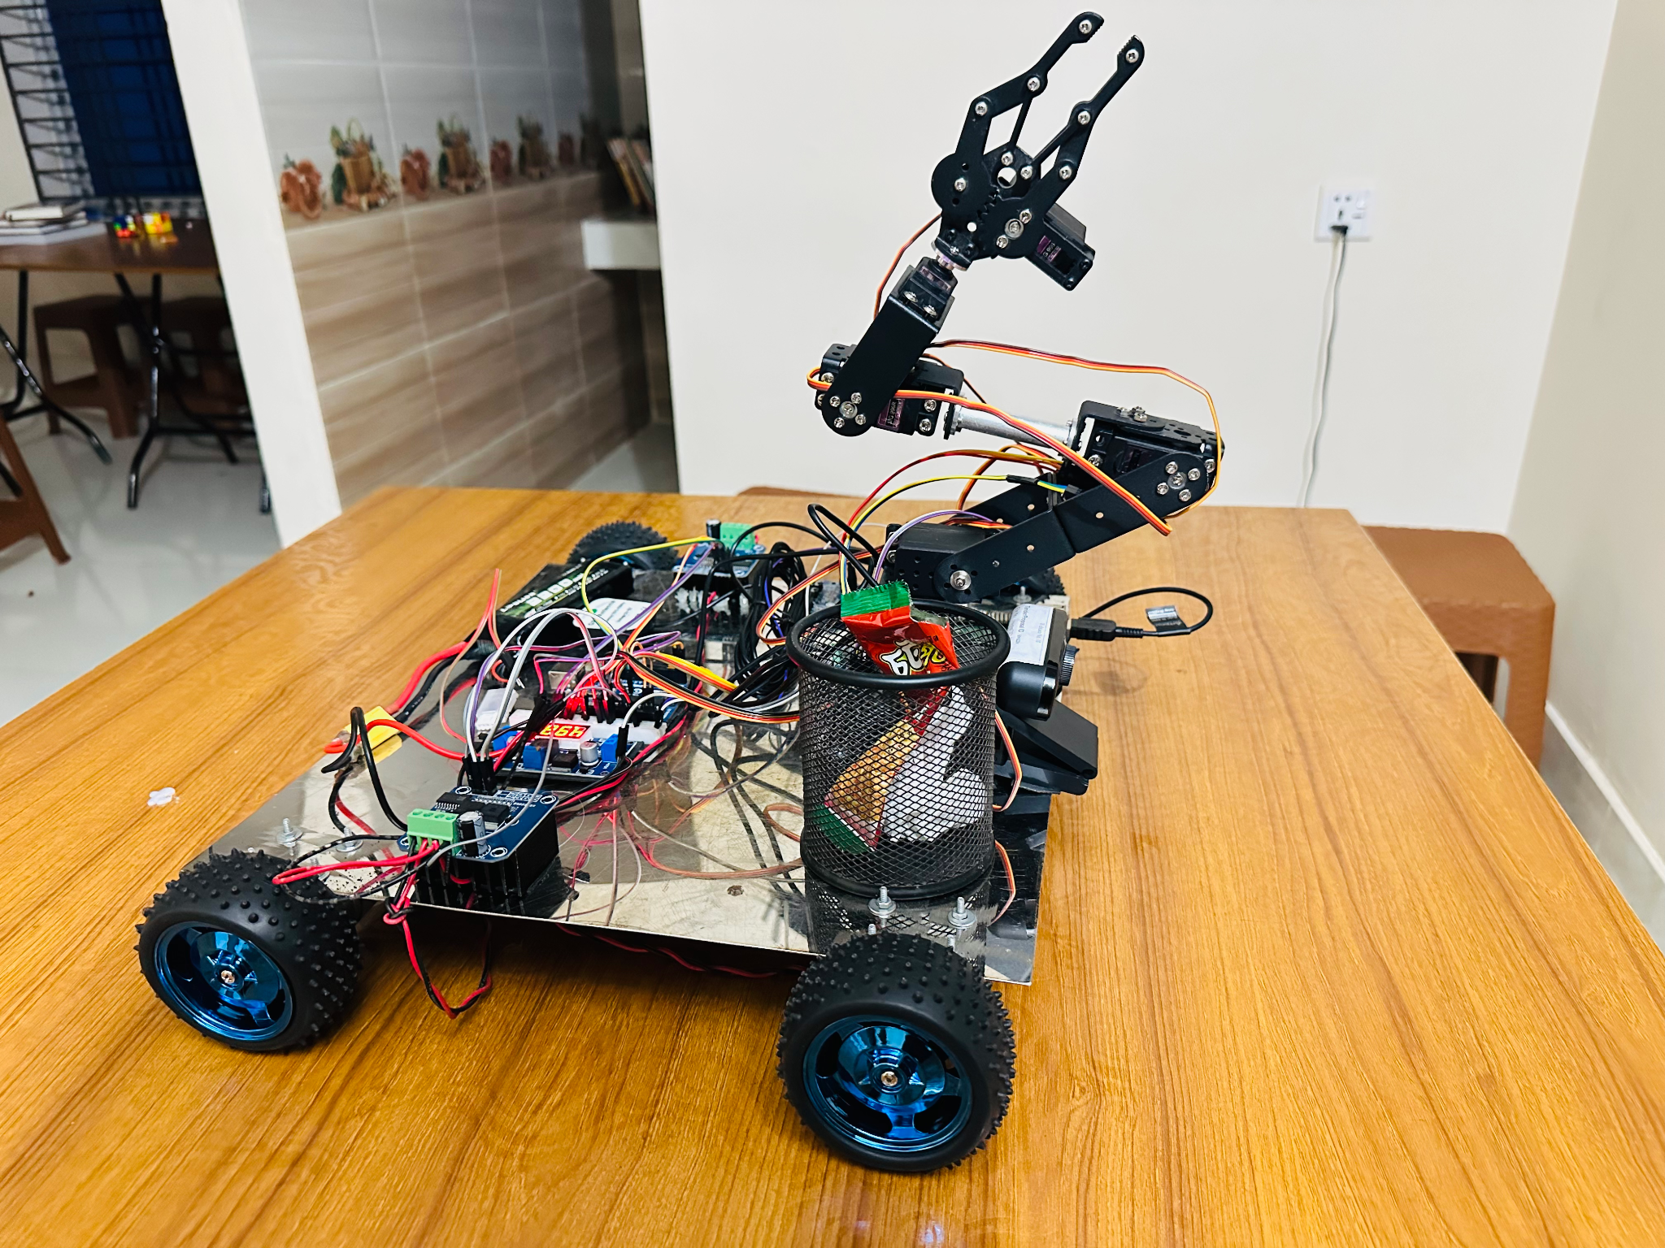
Fig : Complete Hardware Setup

Slide 13
Methodology
Software Tools
The software used for our project are given below:
Arduino IDE
Arduino Programming
ROS2 Humble
Ubuntu OS 22.04
Rviz
Gazebo
Xacro
URDF
Google Colab
Python 3.10
Machine Learning
Jupyter Notebook
VS studio

Slide 14
Methodology
Software Tools
the most essential libraries used in the project are
Moveit,
rclpy,
std_msgs,
geometric_msgs and
Adafruit_PWMServoDriver,
SoftwareSerial,
TinyGPSPlus,
TensorFlow,
OpenCV,
NumPy,
Matplotlib,
Pytorch,
Scikit-learn,

Slide 15
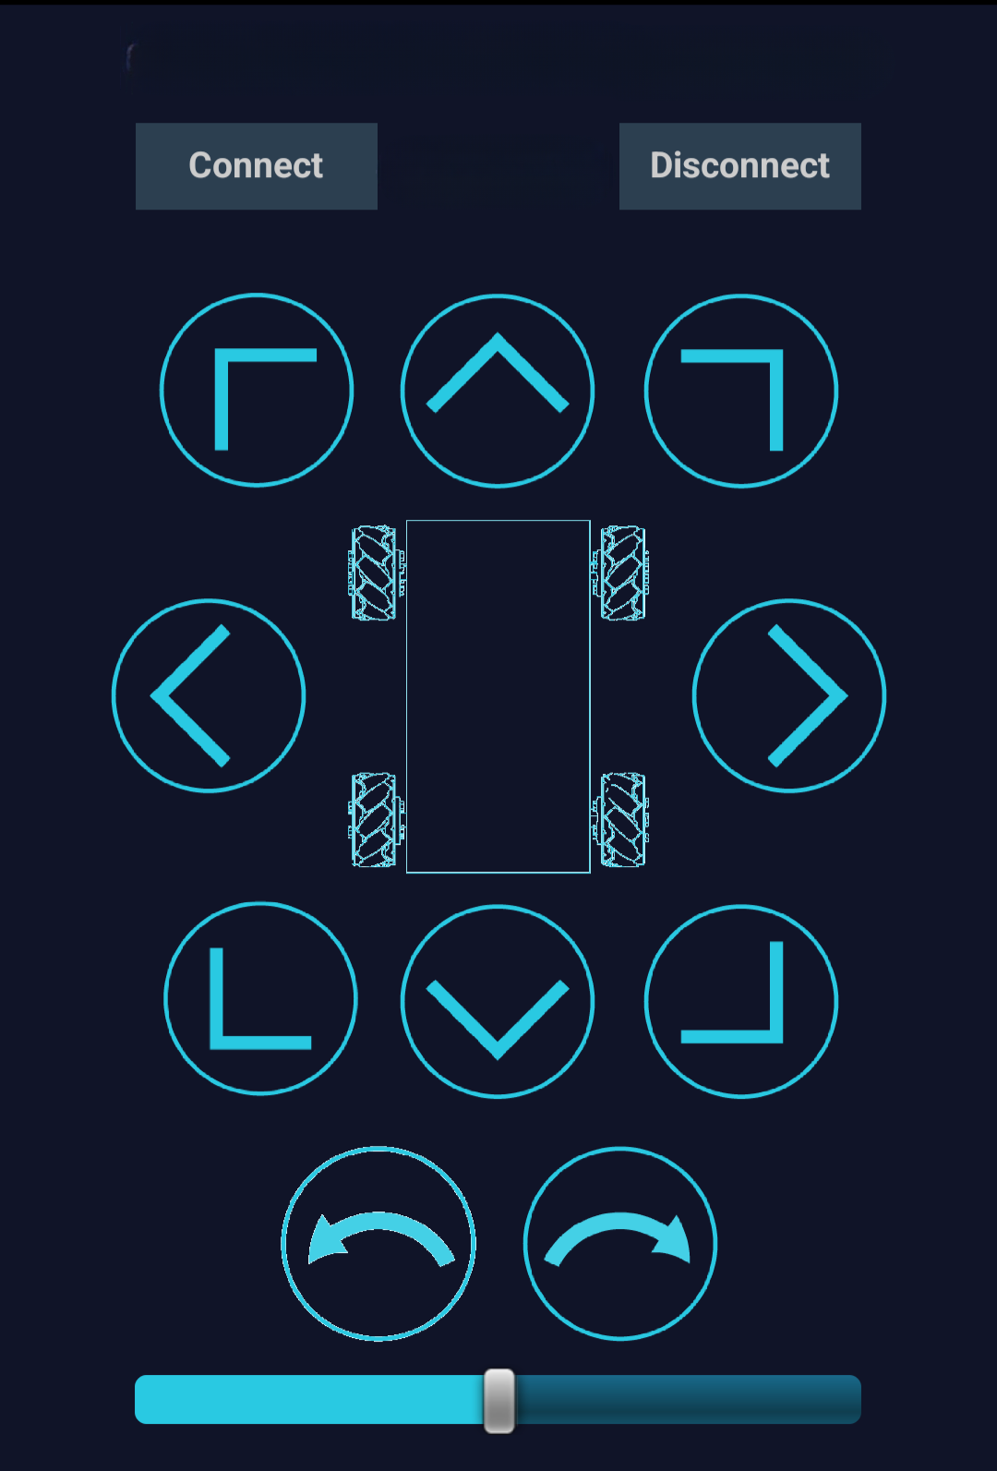
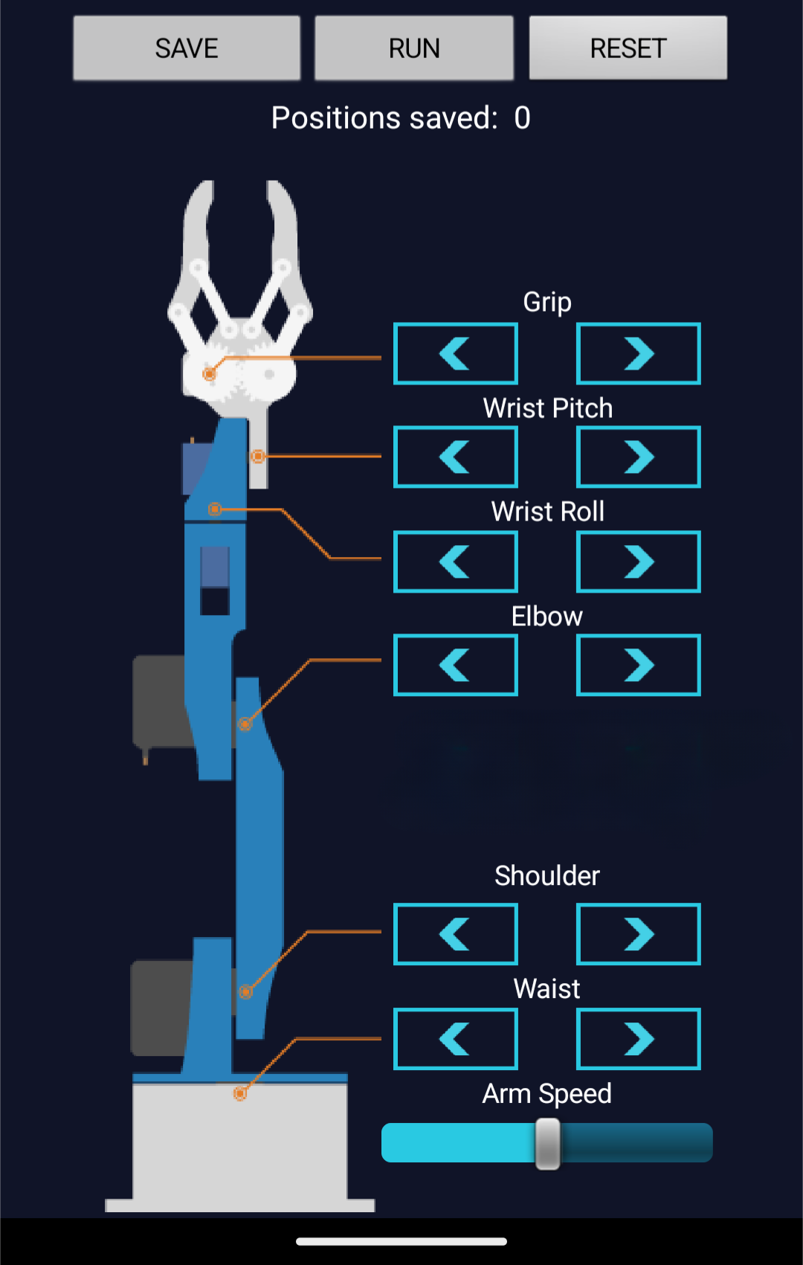
Bluetooth Control
i. MIT App Making
MIT App Inventor, a visual programming platform
mobile application for wireless control of the EnviroBot robotic arm.
The integration aims to provide a user-friendly interface, enabling immediate control via Bluetooth communication.

Slide 16
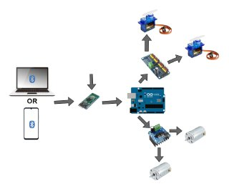
Bluetooth control
ii. Wirelessly control using Bluetooth
enable manual control of the EnviroBot robot
The integration involves sending control commands from the app to the Arduino board,
turn, interprets these commands and actuates the movements of both the wheels and the robotic arm

Slide 17
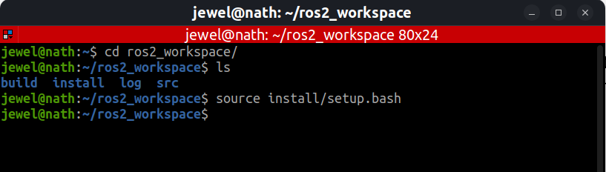
ROS2 Workstation Setup
Ubuntu 22.04 installation
ROS2 Humble Installation
Colcon Build

Slide 18
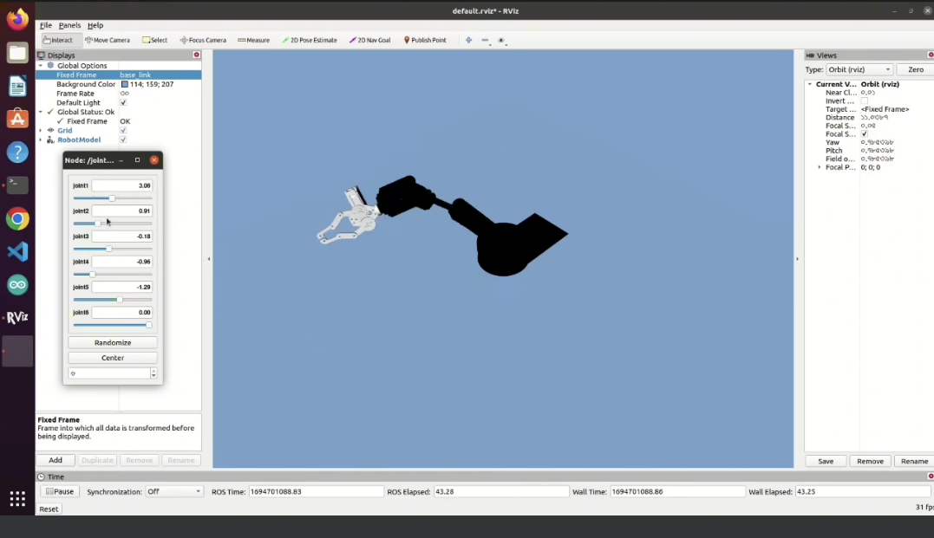
Robot Visualization( Rviz )

Slide 19
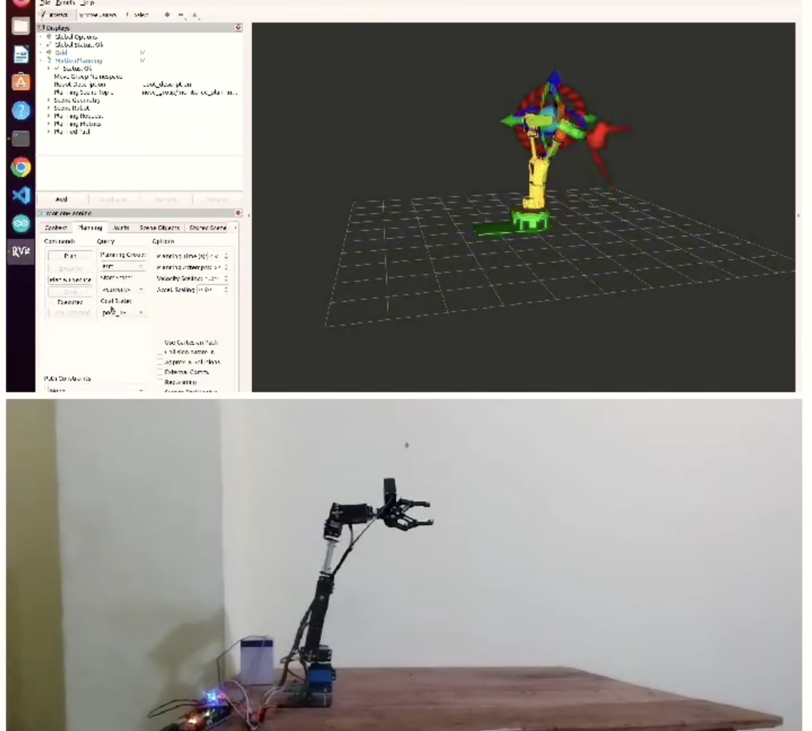
MoveIt Configuration

Slide 20
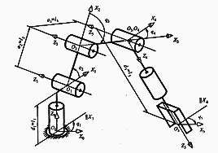
MoveIt Configuration

Slide 21
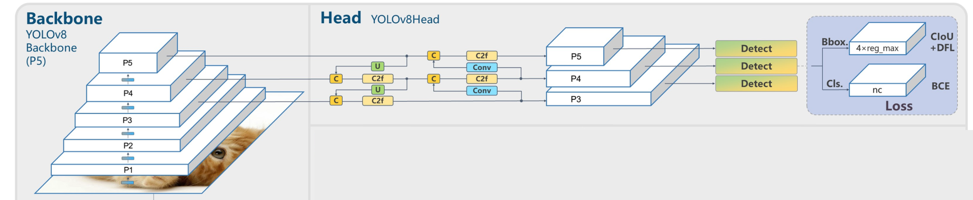
Model Train
Training Set (70%): 1226 images are used to train the YOLO model.
Validation Set (20%): 350 images are reserved for fine-tuning model hyperparameters.
Test Set (10%): 176 images are used for evaluating the model's performance on unseen data.
Fig: YoloV8 Architecture

Slide 22
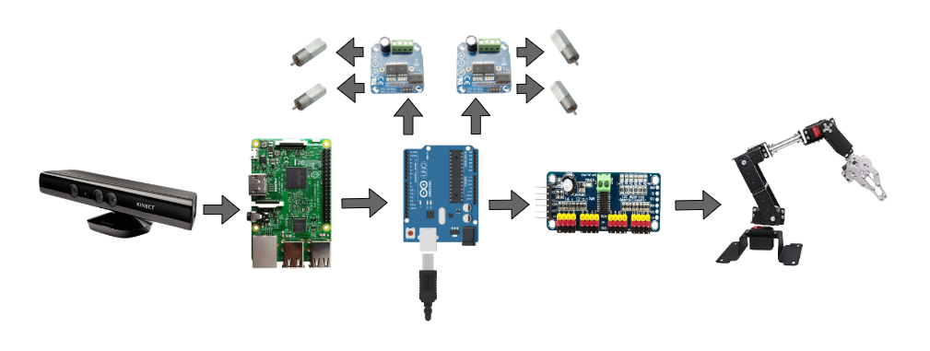
Integration Model with ROS2
Fig : Data Flow overview

Slide 23
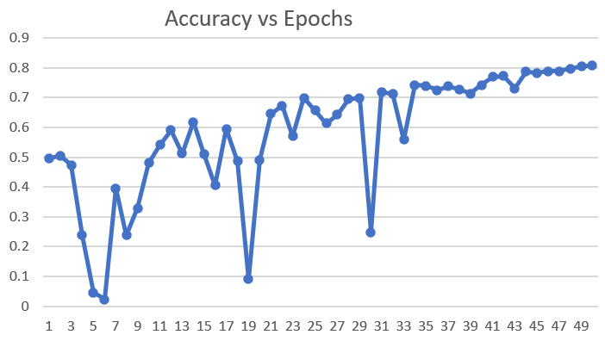
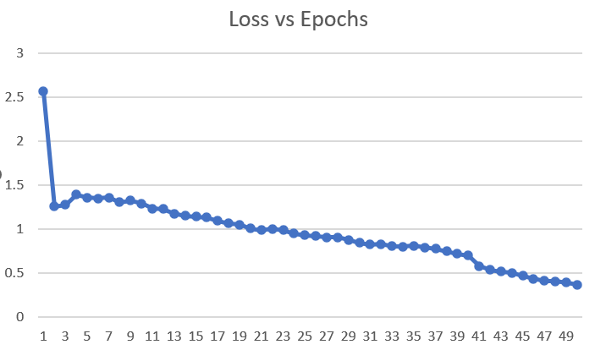
Result and Finding
1. Enhanced Mobility:
- Precision in movement, navigating both smooth and rough terrains effortlessly.
2. Flexible Robotics Arm:
- Six articulated joints for unmatched precision and adaptability.
3. Performance of YOLO v8:
- Integration of YOLO v8 model for waste detection with an 80% accuracy rate.
- Effective convergence over 50 epochs, Steady increase in accuracy and consistent decrease in loss, especially after the 30th epoch.

Slide 24
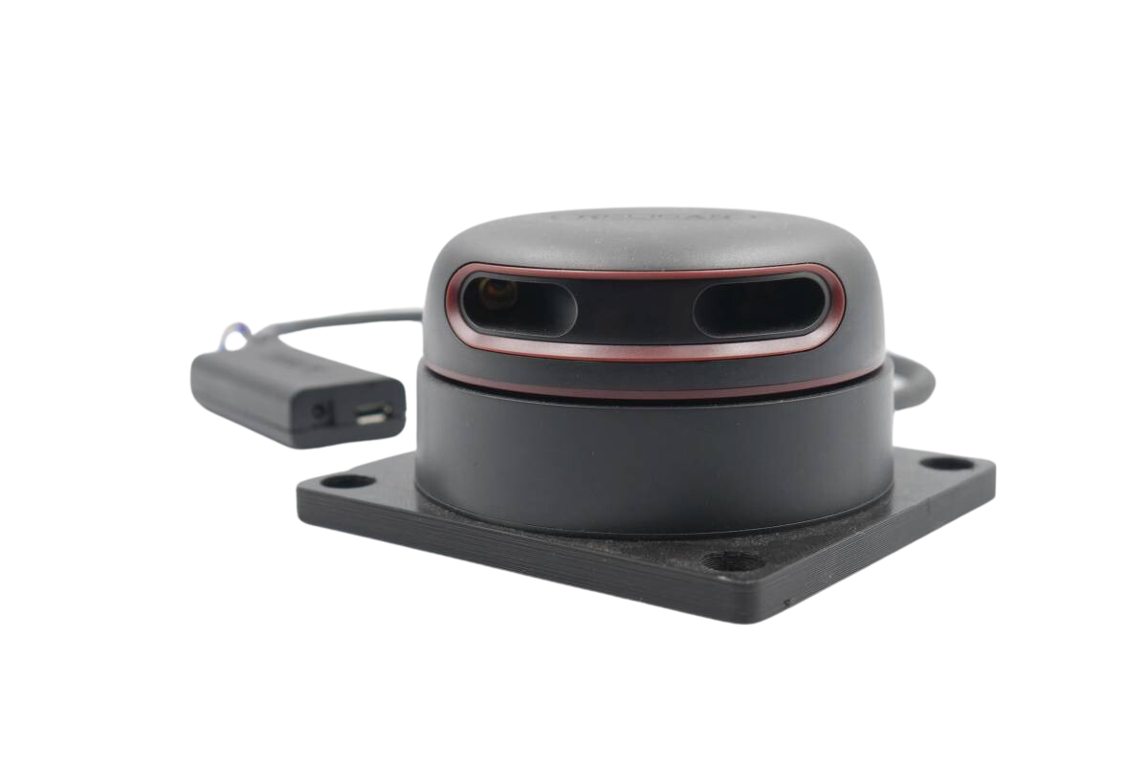
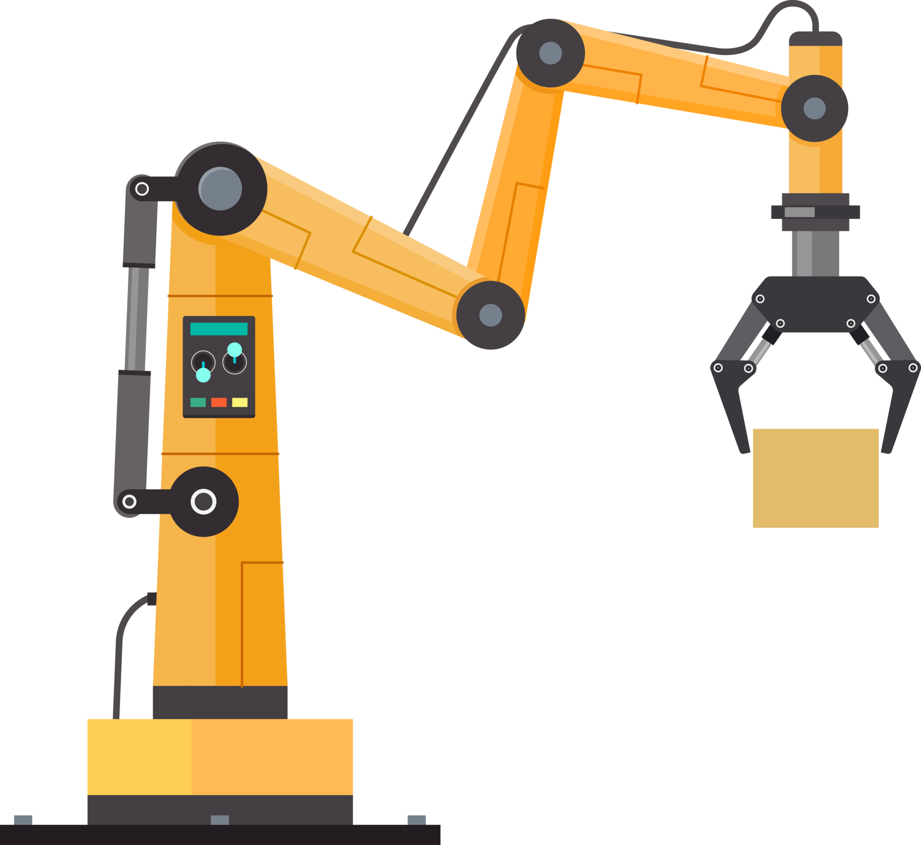
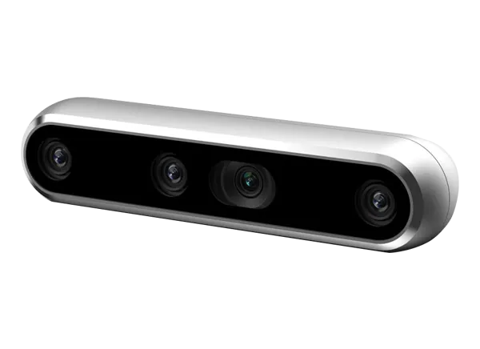
Future Work
Depth Camera
Lidar
Industrial Robotics Arm

Slide 25
Conclusion
Our project achieved an efficient waste disposal system using a four-wheeled robotic arm and streamlined object identification.
Systematic collection and separation of diverse trash types, including plastic and paper, showcase our commitment to organized waste management.
Our responsible approach addresses environmental impact, contributing to a cleaner environment and exemplifying a transformative step toward sustainable waste management.

Slide 26
References
[1] Megalingam, R.K., Katta, N., Geesala, R., Yadav, P.K. and Rangaiah, R.C., 2018, December. Keyboard-based control and simulation of 6-DOF robotic arm using ROS. In 2018 4th International Conference on Computing Communication and Automation (ICCCA) (pp. 1-5). IEEE.
[2] Khan, M.A., Khan, D.M.Z., Khan, H., Hanzla, M., Jamal, M., Khalid, T. and Ullah, N., 2020. Garbage collector robot. Indian J. Sci. Technol, 13(20), pp.2065-2070.

Slide 27
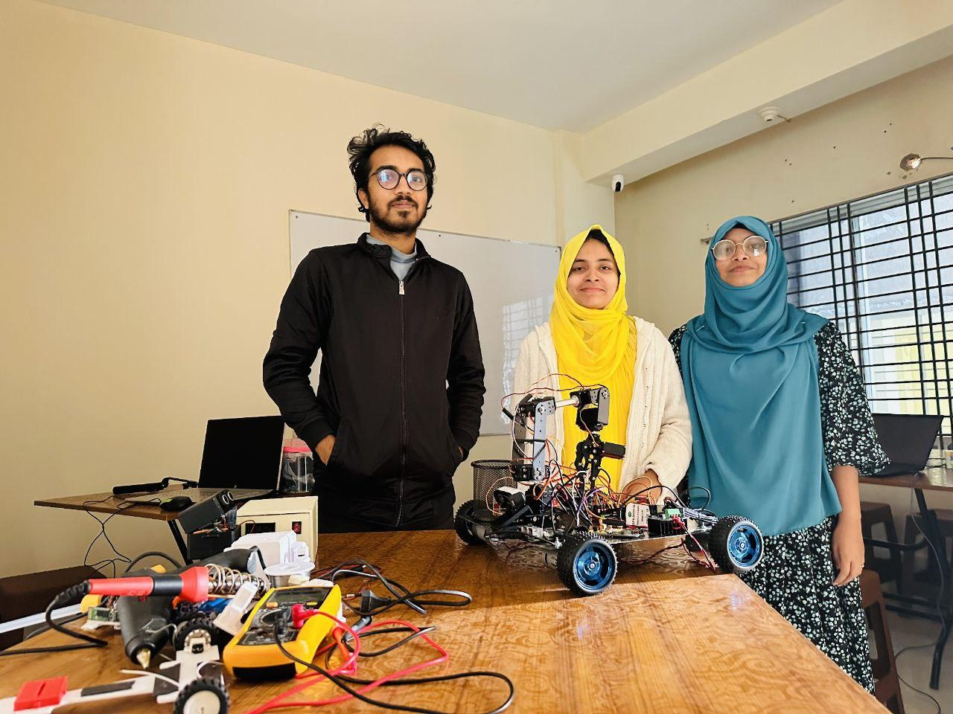
Thank You

